Slide 1
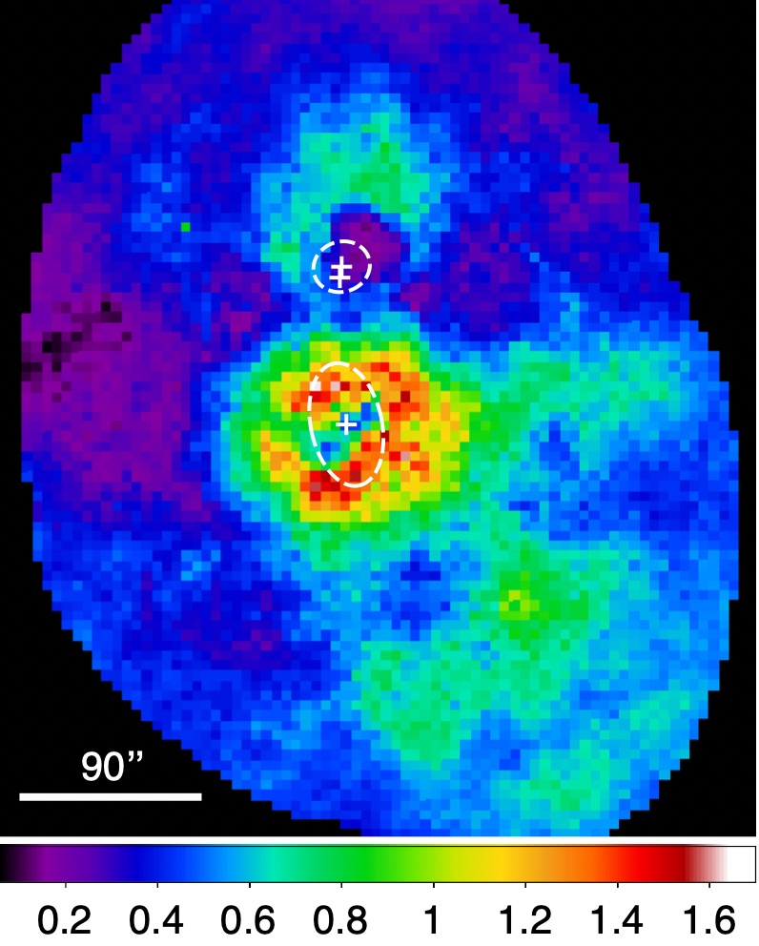
The Metal Content of the Hot Atmospheres of Galaxy Groups Fabio Gastaldello (INAF-IASF Milano) A. Simionescu, F. Mernier, V. Biffi, M. Gaspari, K. Sato, K. Matsushita
Abundance map of the NGC 6338 group merger O‘Sullivan+19

Slide 2
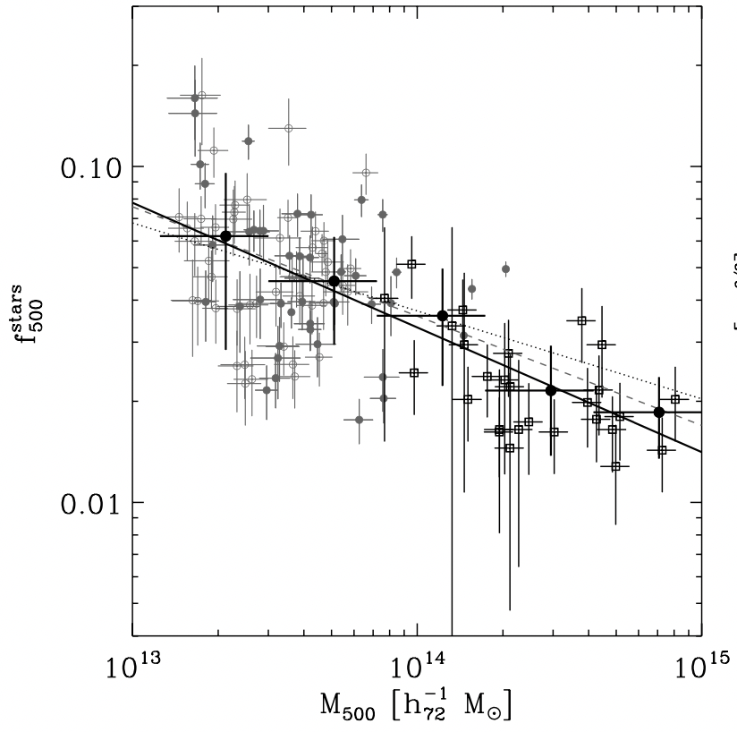
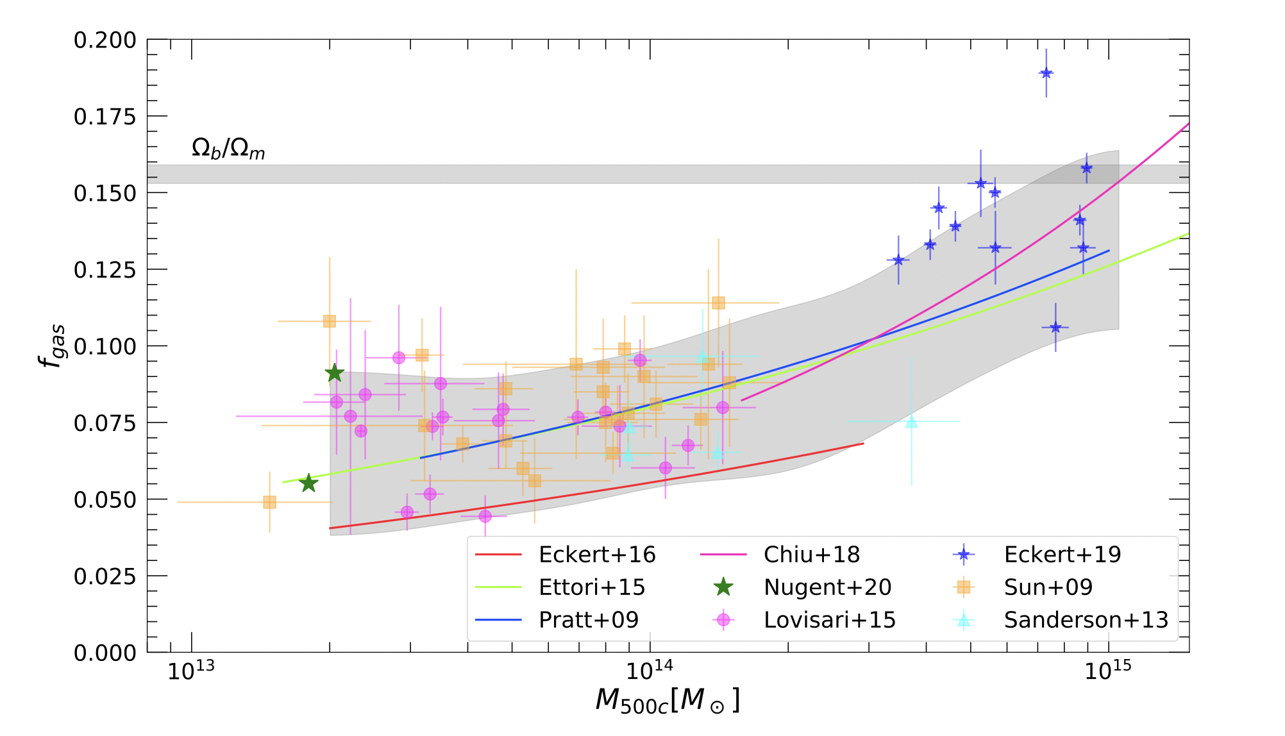
Why should we care about Metals in Groups ?
They host the majority of matter and possibly of metals
Importance to investigate metal budgets in different type of systems
Metals link stars and hot plasma and we have a very different mix in groups with respect to clusters, clearly related to the different impact of feedback (AGN and SN)
They are tracers of the physical processes: mergers, feedback chemiodynamics !
Giodini+09
Eckert+21
Notes:
Qui mancano due slides

Slide 3
Measuring abundances in the IGrM
ε_{line} ≈ n_{e}n_{Z}
ε_{ff} ≈ n_{e}n_{p}
ΕW ∝ n_{Z} / n_{p}
“The analysis is very straightforward compared to the analysis of stellar or H II region spectra, where the effects of radiative transfer, dust and ionization balance are very complex and difficult to remove accurately. In many respects, it is easier to derive the abundances from X- ray spectra of the ICM in clusters than in any other field of astrophysics”
Mushotzky+96
ff
Boehringer & Werner 10
rr
2ph
Line cooling, recombination and 2 photon processes relevant with respect to hotter plasma in clusters

Slide 4
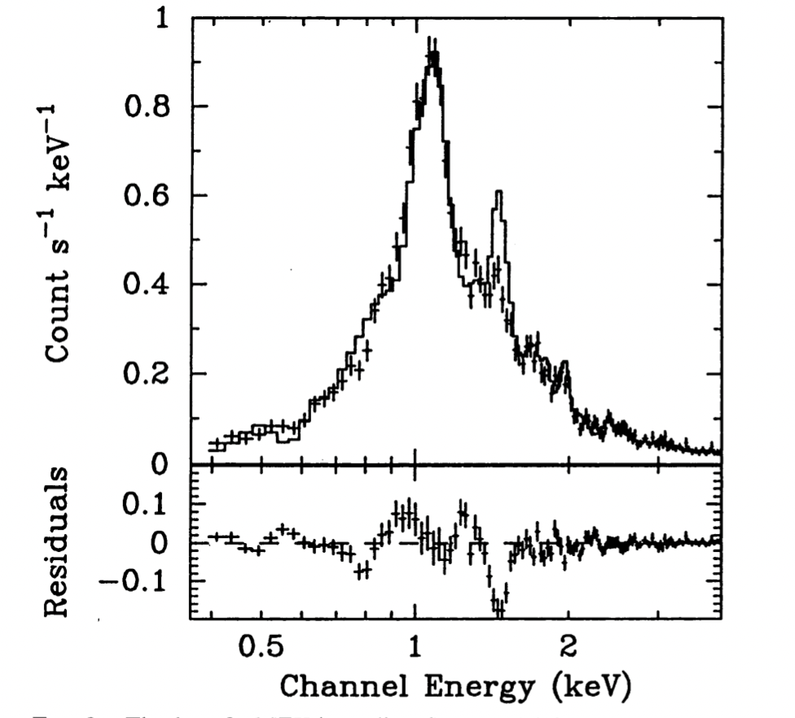
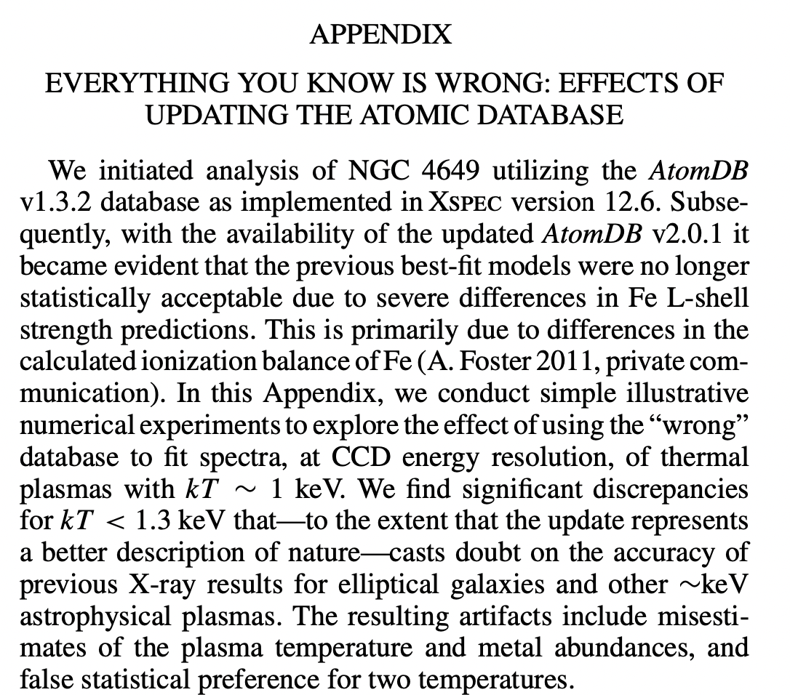
The Fe-L shell: a gift but also a curse
Fabian+94
Key signature of the Fe-L complex which has been historically difficult to model in plasma codes
Loewenstein+12

Slide 5
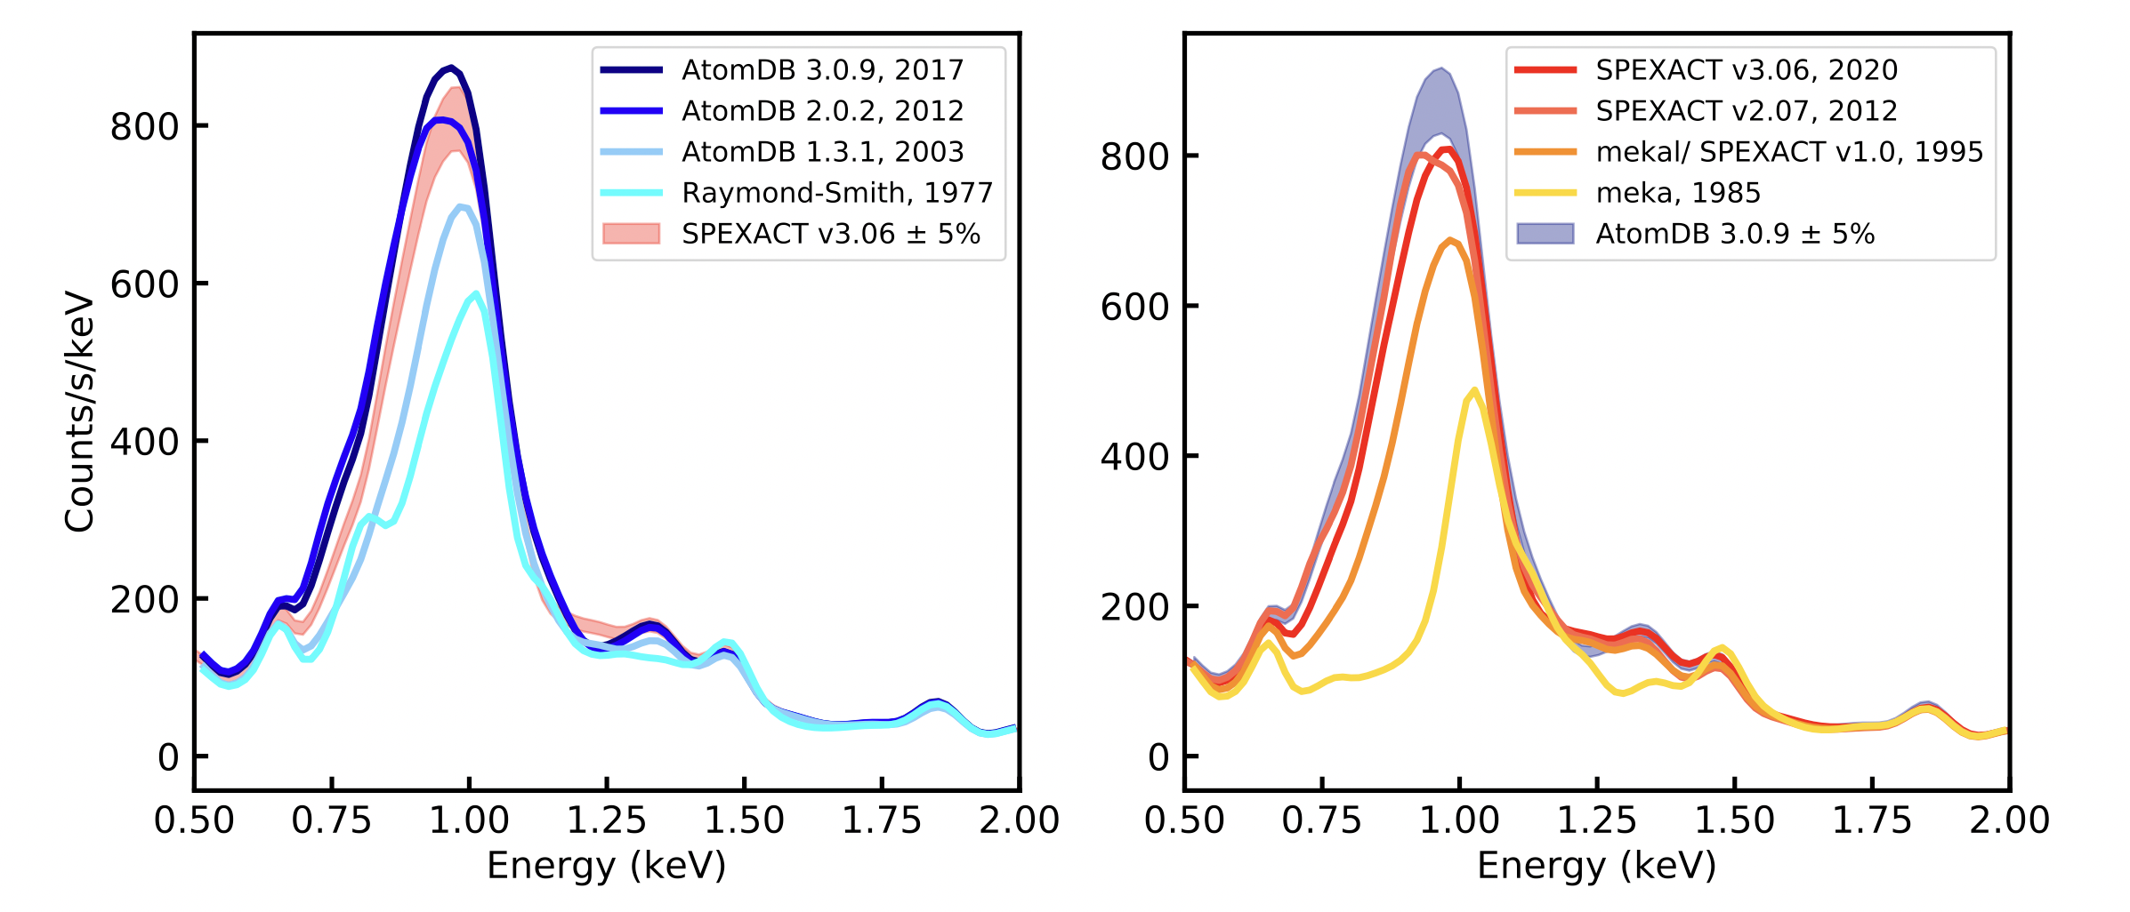
The Fe-L shell: a gift but also a curse
SPEXACT and AtomDB converging in recent years at CCD-level resolution of the order of 5-10 % at 1 keV
Gastaldello+21

Slide 6
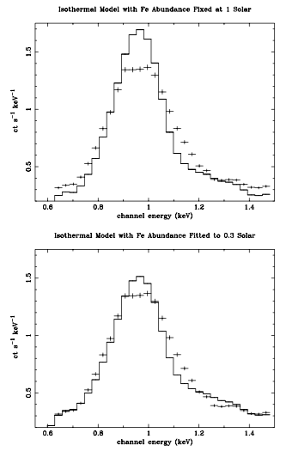
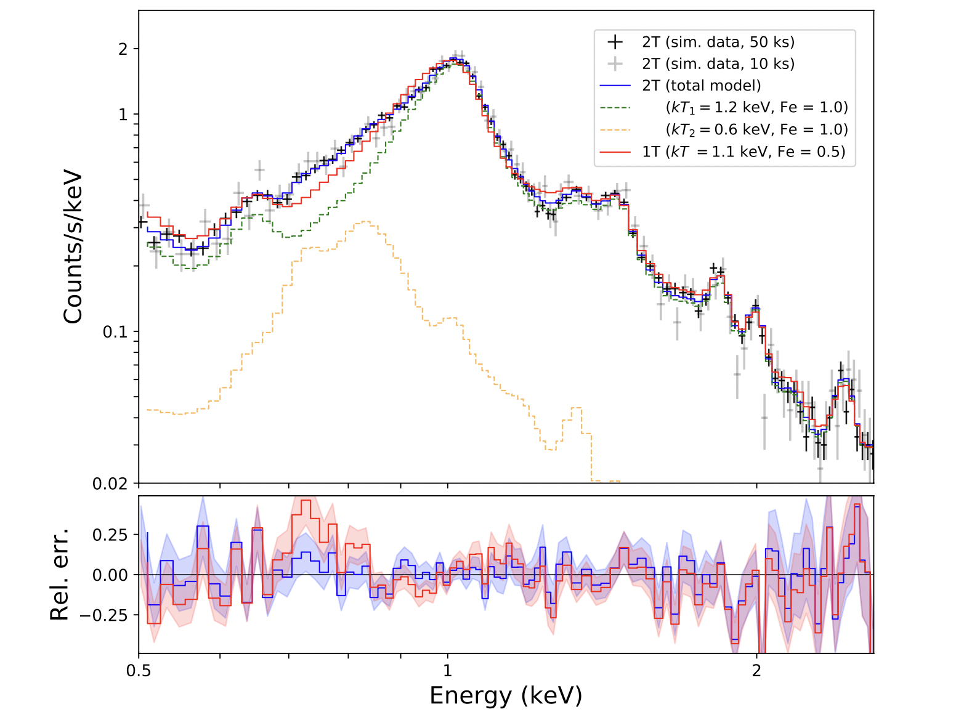
The Fe-bias
Buote 00
Abundances sensitive to the presence of multi-temperature plasma (cooling, projection) when fitted with a single temperature
Gastaldello+21

Slide 7
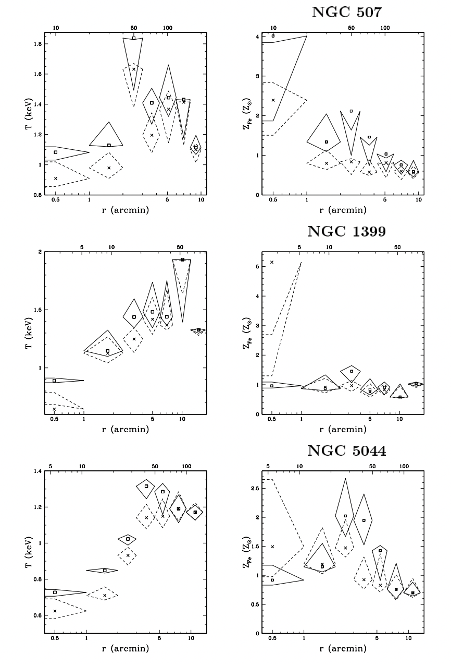
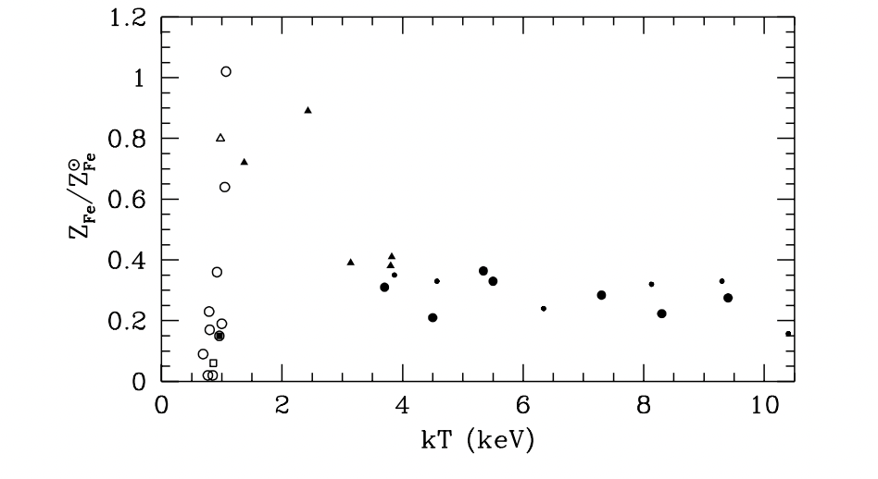
Early measurements with ROSAT and ASCA
Buote 00
Renzini+97
Early puzzling low abundances mainly coming from Fe bias (and different abundance tables, Asplund in this talk). Evidence of Fe gradients in X-ray bright (“CC”) groups

Slide 8
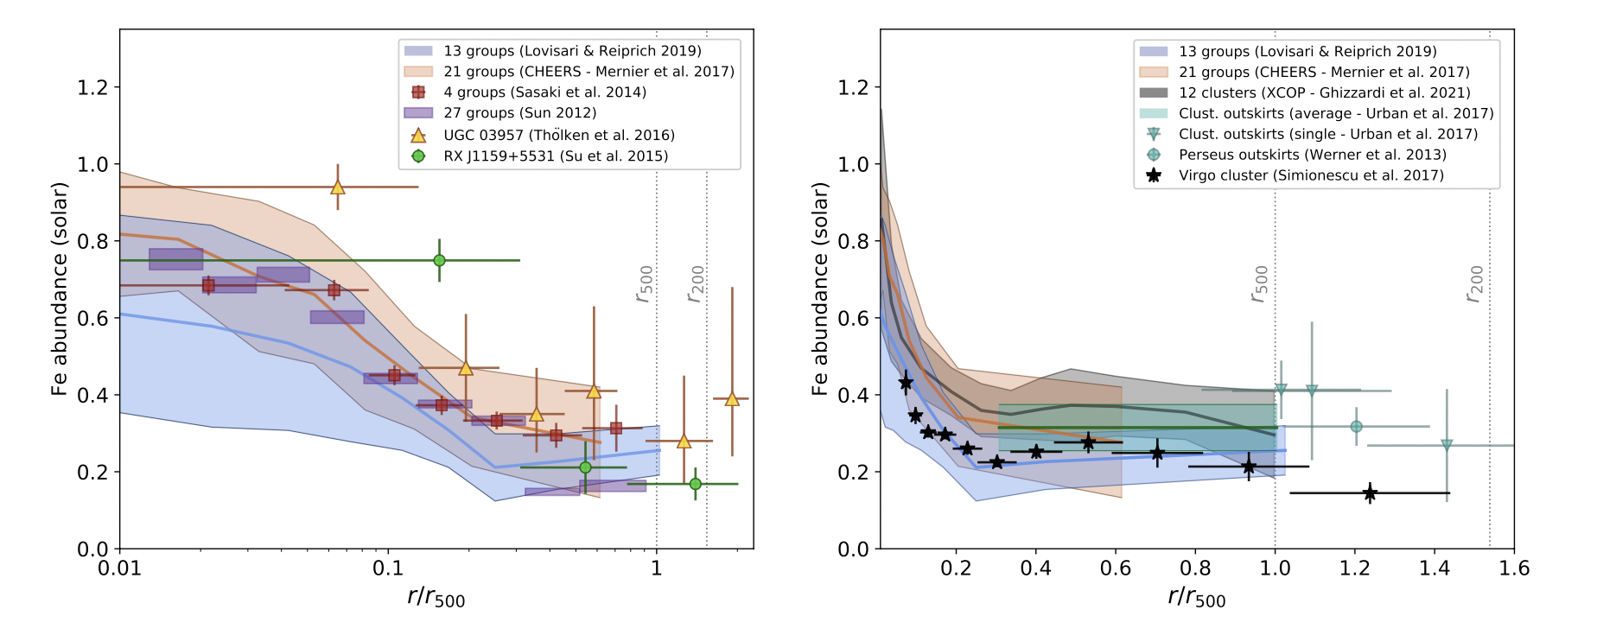
The current status of abundance profiles
Thanks to XMM, Chandra and Suzaku significant improvement in the metallicity measurements
Metallicity increase towards the core (maximum half solar to super-solar)
Decrease outside the core with similar slopes and still to be confirmed if it reaches a general plateau as in clusters at a value of 0.35 solar
Trends with system mass reported with slighly higher abundance at the group scale in the core

Slide 9
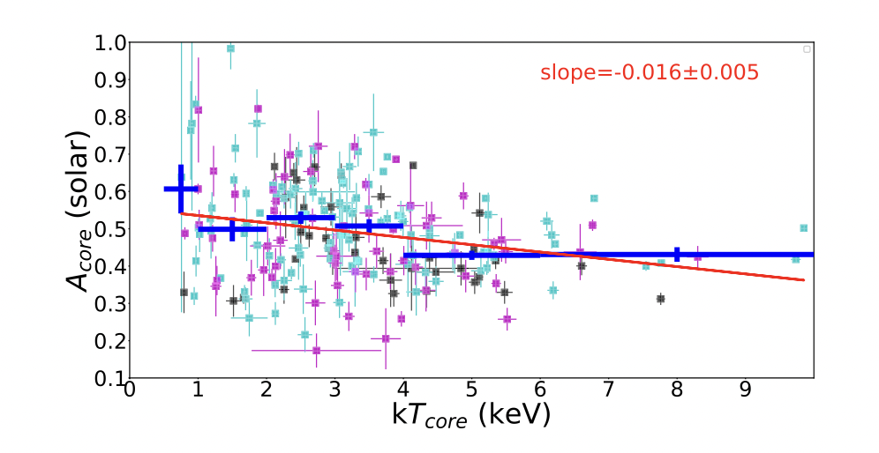
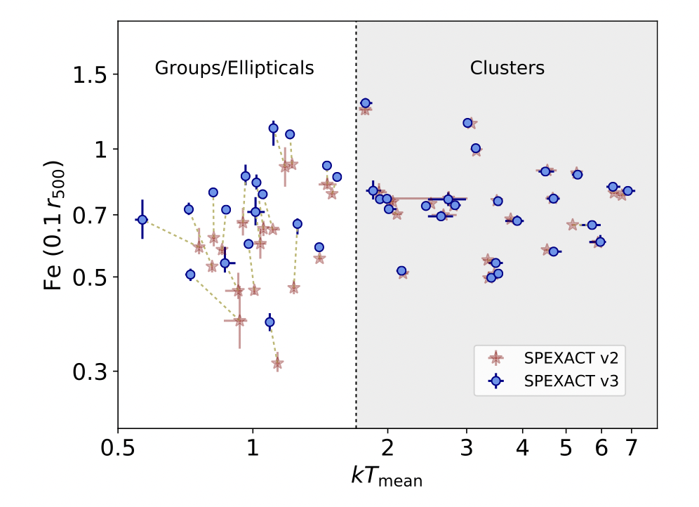
In the core
Lovisari & Reiprich 2019
Mernier+18
Much of the scatter in the core due to merger (no peaked SB or T drop) and AGN (central radio source) activity. Sample selection (with relative proportions of the categories) is again key to interpret trends. Still small numbers at the group scale

Slide 10
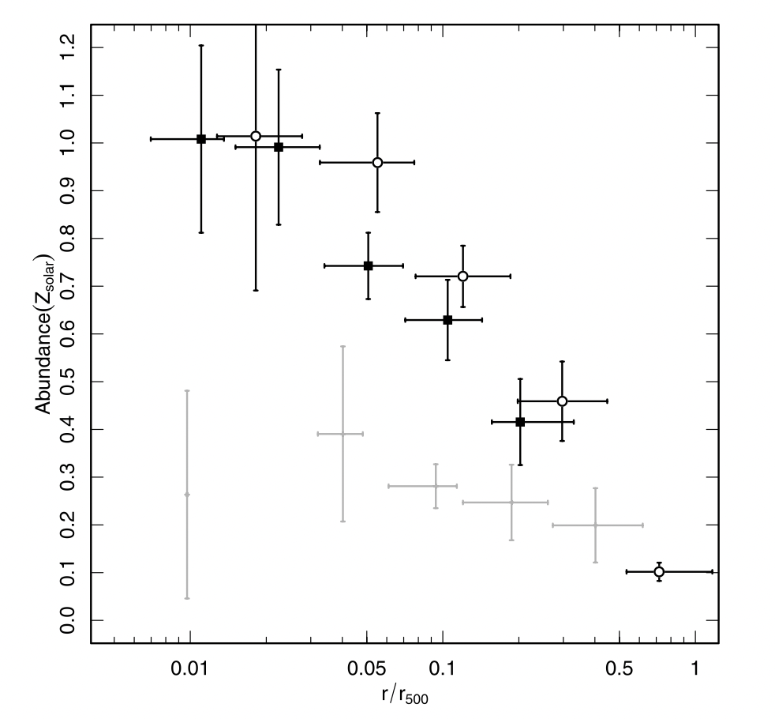
In the core
CC with radio
CC no radio
NCC
Johnson+11, AG89 units
NCC systems related to merger are only starting to be explored at the group regime, as they are even more difficult to observe (e.g. Xu+18)

Slide 11
Beyond the core
Critical to establish if we are at values closer to 0.3 or 0.2 solar and lower in the outer region – most of the volume – most of the metal mass, for both uniform enrichment scenarios and models of chemical enrichment – SN yields

Slide 12
Chemical composition
Rasmussen & Ponman 09, AG89 units
Measuring abundance ratios can in principle constrain the relative contribution of SNcc and SNIa, in particular the ratios of elemnts such as O, Mg, Si over Fe.
Early ASCA (Finoguenov & Ponman 99) and Chandra measurements (Rasmussen & Ponman 09) pointed to a radially changing Si/Fe thus an increasing contribution of SNcc. This does not seem to be the case anymore

Slide 13
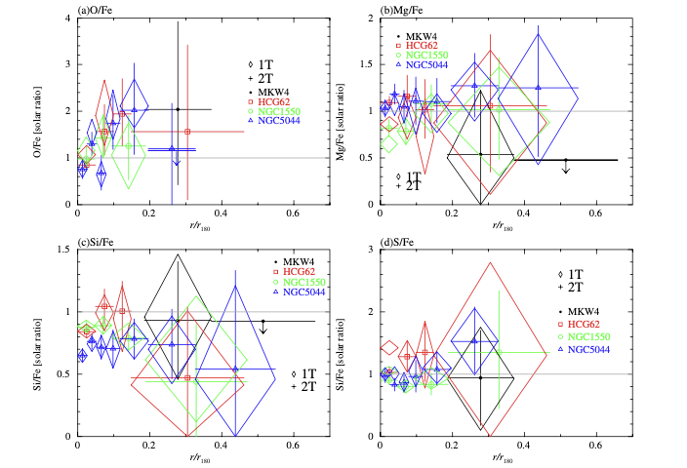
Chemical composition
Sasaki+14
Suzaku measurements at large radii (Sasaki+14) and accurate XMM measurements (e.g. CHEERS sample, Mernier+18, see also De Grandi & Molendi 09) provide instead a picture of a uniform chemical composition close to the solar abundance and consistent with a early uniform enrichment at high z in agreement with the picture provided by galaxy clusters

Slide 14
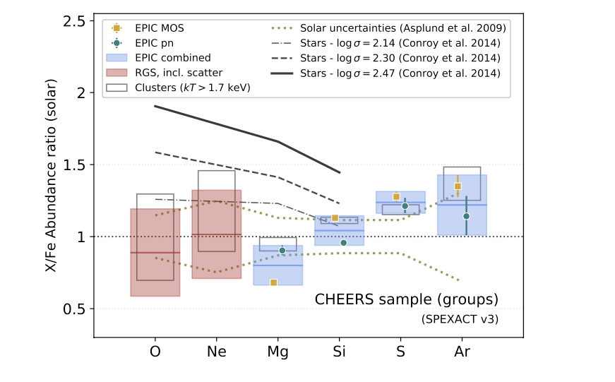
Chemical composition
Gastaldello+21
Chemical pattern in the IGrM (and ICM) is crucially different from the one of stars in BGG/BCGs and this makes the delay time of SNIa clusters quite constrained (not too early, not too late)

Slide 15
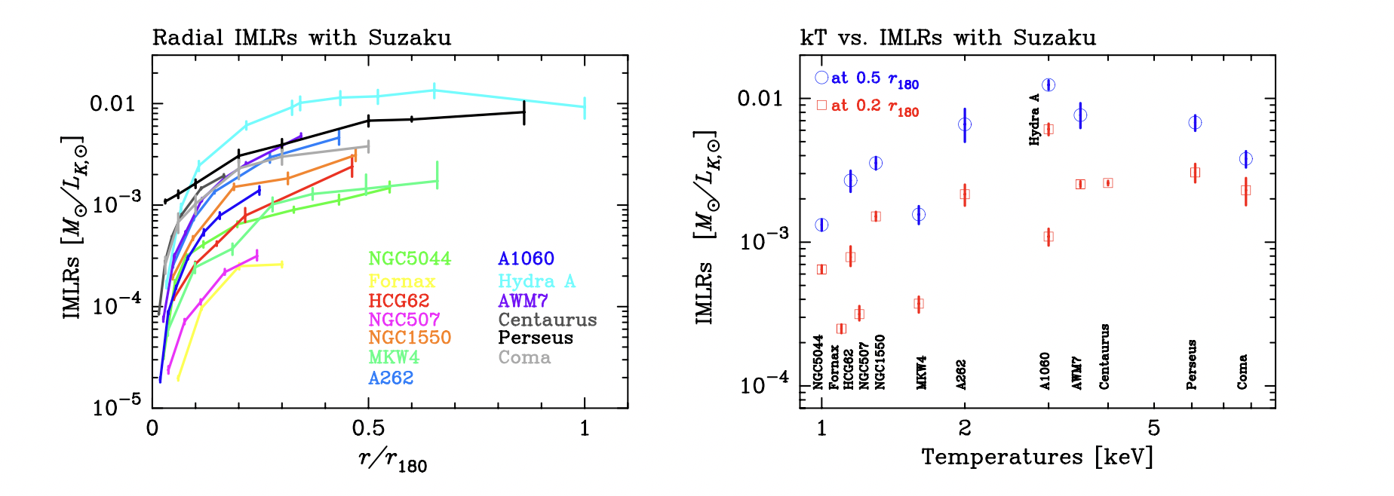
Metal mass budgets
Gastaldello+21
The physically meaningful quantities are the metal mass and the stellar mass. A direct observational proxy is the ratio iron mass and the total light, the IML (Renzini & Ciotti 93). They are lower in the inner regions for groups with respect to clusters but they are closer to each other at large radii. Did feedback prevented metals to accumulate in the inner regions of their shallower potential wells ?

Slide 16
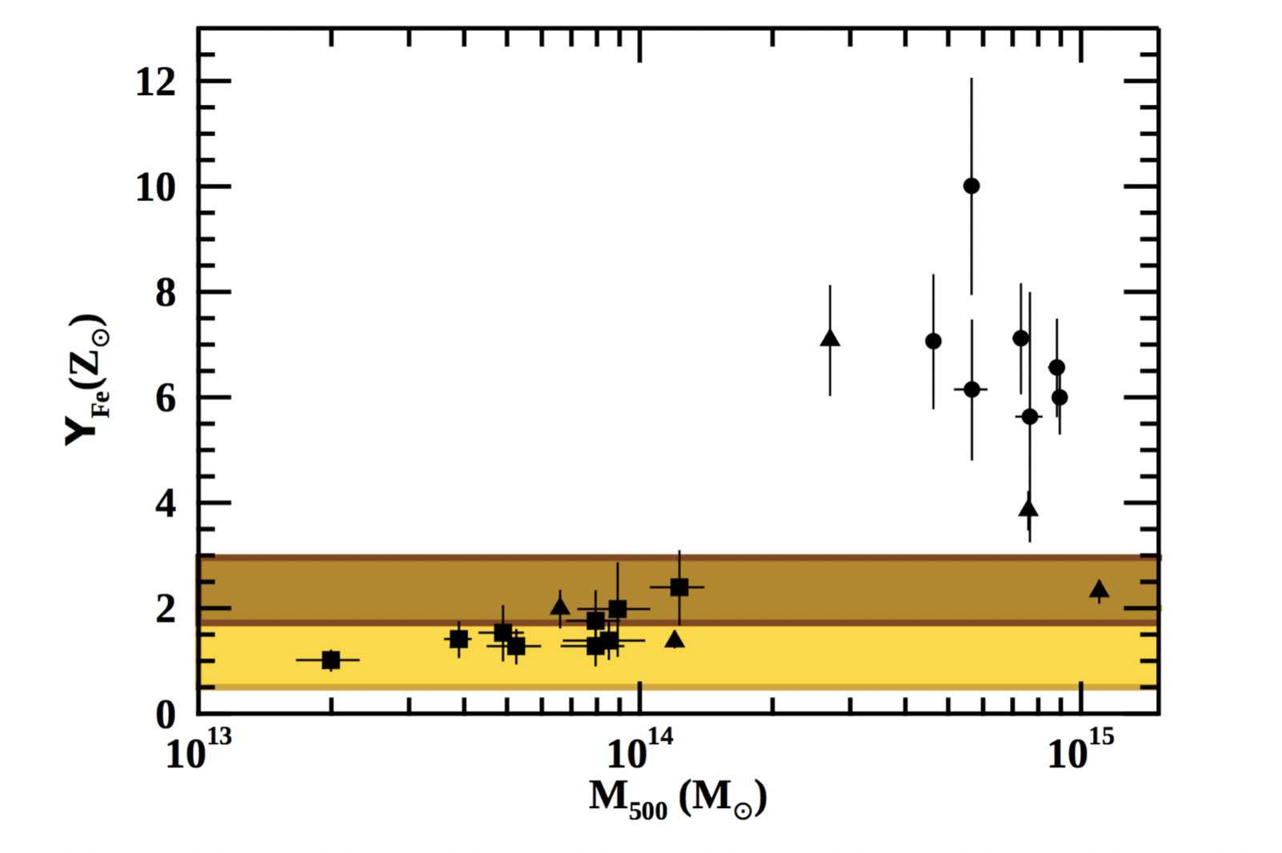
Metal mass budgets
Gastaldello+21
The iron yield is a fundamental quantity in chemical evolution models. You need a full inventory under the assumption of a closed system. If metals can escape/no collapse then no strong inference can be made. It is premature to draw conclusions at the group scale. This plot should be populated with more systems and ideally at larger radii (r200).

Slide 17
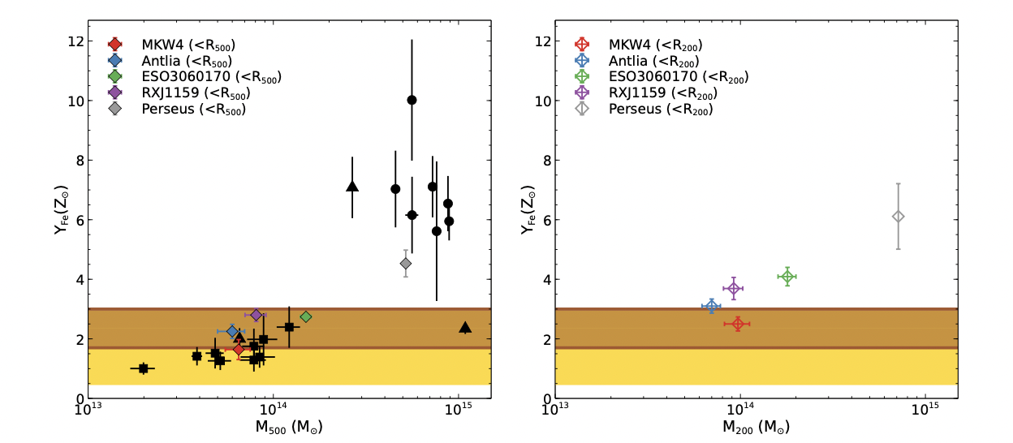
Metal mass budgets
See also Molendi’s and Ayromlou’s talks
Sarkar+22

Slide 18
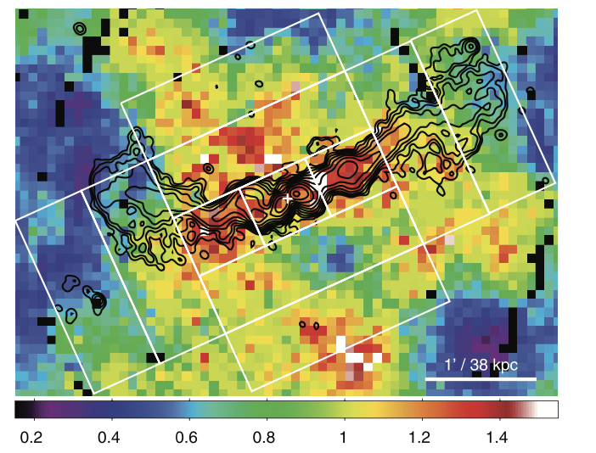
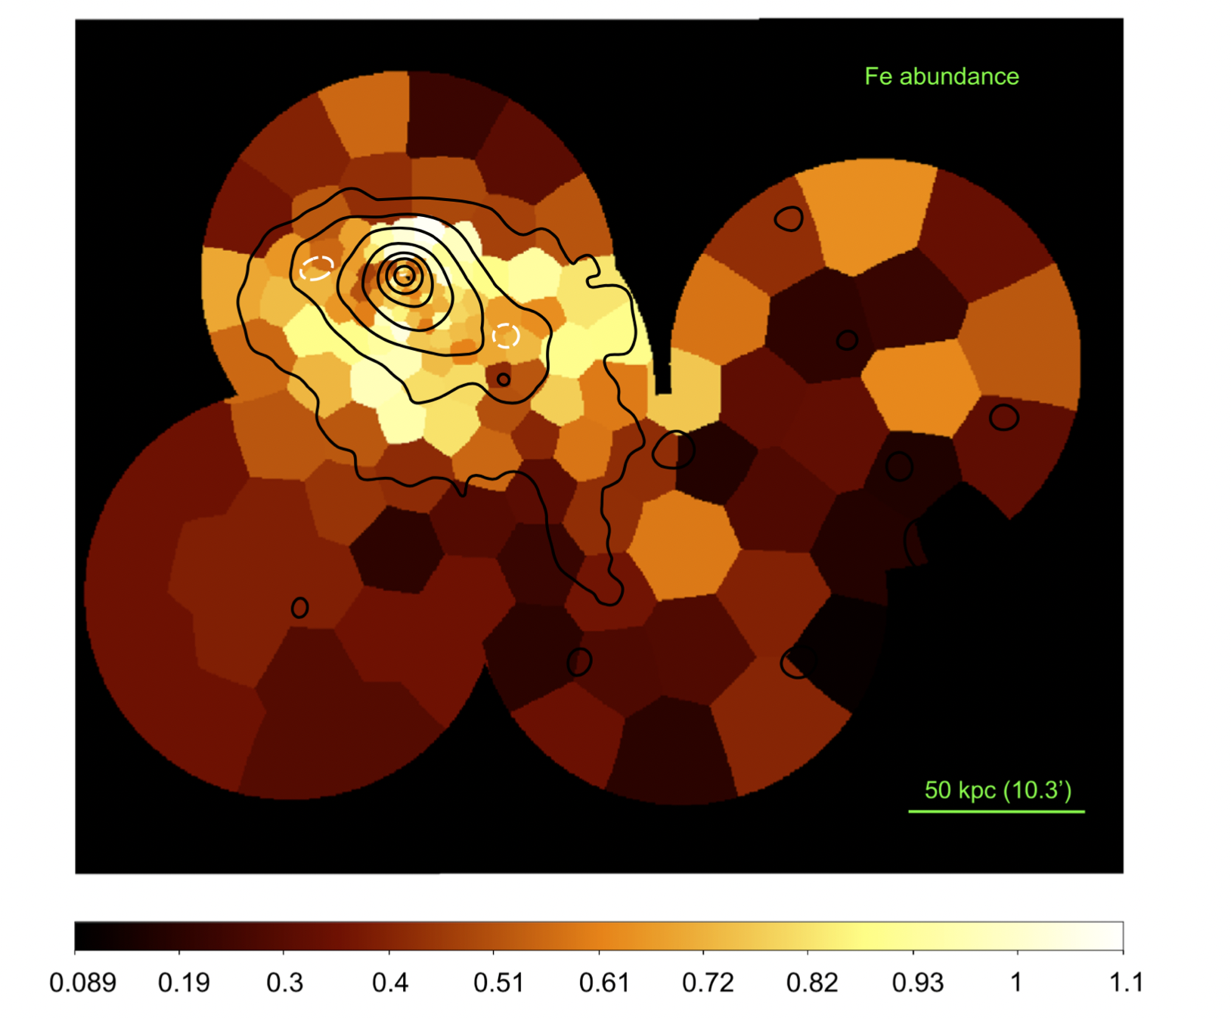
2D Maps
O’Sullivan+14
Su+19
O’Sullivan+11
Abundance maps are showing the effects of AGN feedback, sloshing and ram-pressure stripping. We should do more of these with inclusion of multi-T modeling

Slide 19
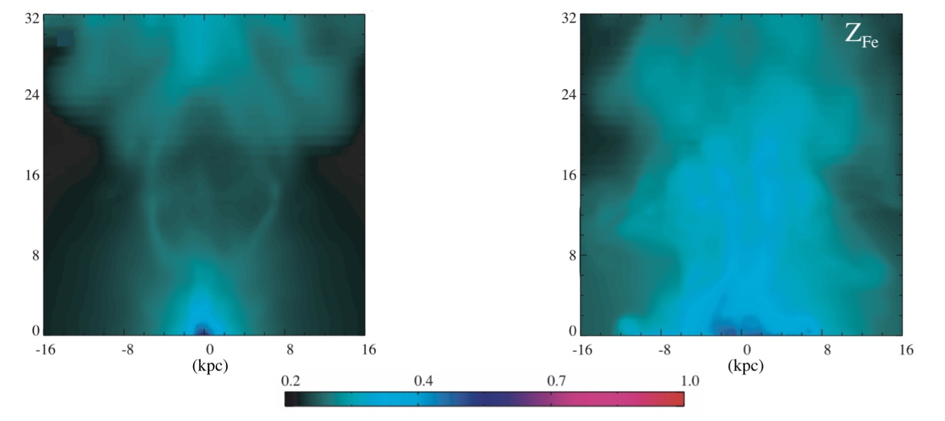
High resolution Hydro Simulations
Gastaldello+21
CCA
HOT
Abundance maps can discriminate AGN feeding models, e.g. CCA/cold gives gives a very intermittent duty cicle closely related to the recent cooling rate with bubbles, shgocks and entrainment of metals, Bondi/hot drives a continuous AGN feedback with monolithic, wide and uniform cylinder of metals (but see Nobel’s talk)

Slide 20
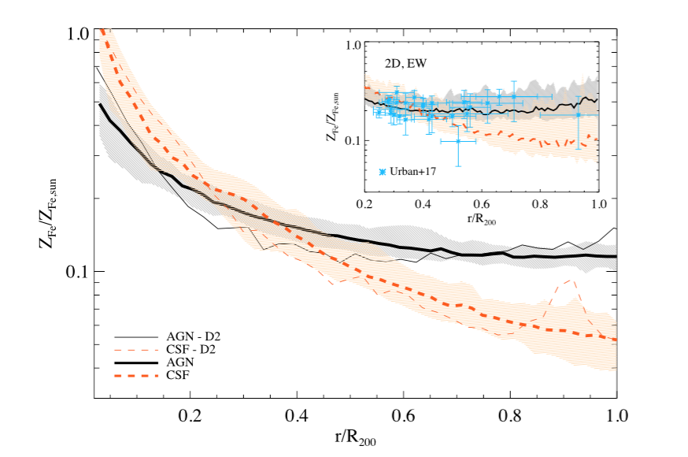
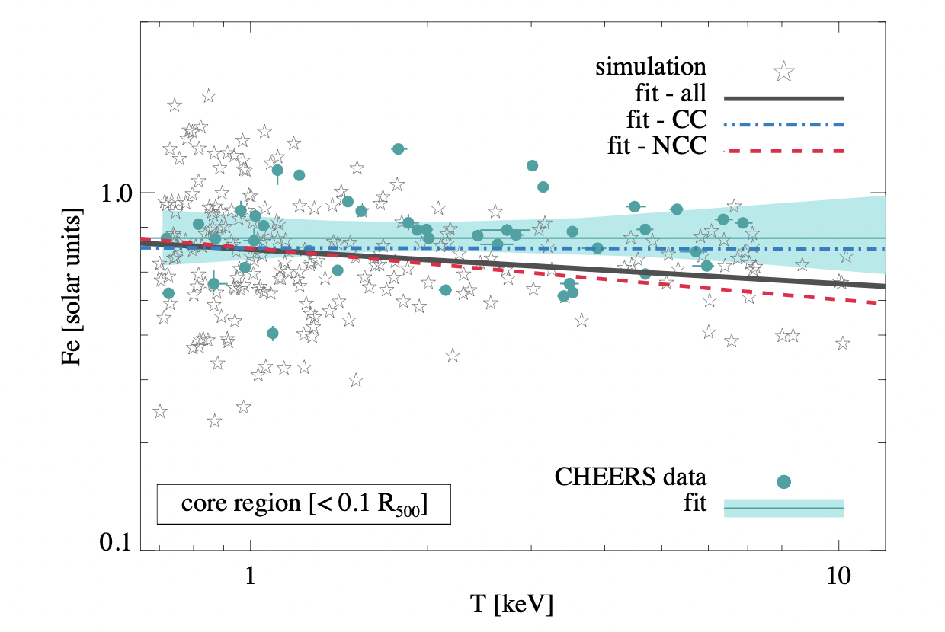
Cosmological Hydro Simulations
CCA
Biffi+18
Adapted from Truong+19
Effect of early AGN feedback necessary to reproduce the uniform enrichment at large radii. Importance of the weight (mass, emission) to match with the observational results. Similar chemical enrichment in groups and clusters supported by the very shallow dependence of metallicity with mass

Slide 21
Take home messages
Plasma codes converging at CCD resolution
Tentative flattening at large radii (need to establish the overall level)
CCA
Solar ratios in the IGrM
Metal budgets need to be done at large radii

Slide 22
Open Questions
What is the metal abundance of groups at large radii (by that I mean at least r₅₀₀, really ideally at least r₂₀₀₎ ?
What is the chemical pattern (Si/Fe, O/Fe ...) of groups at large radii ?
Are we sure we do not have the same problems that we have at the cluster mass scale to produce the observed metal masses with the observed stellar mass ?
How to make progress in the comparison between observations and simulations (e.g. 2D maps) ?
Can we trace the evolution with redshift of metallicity in groups ?
CCA

Slide 23
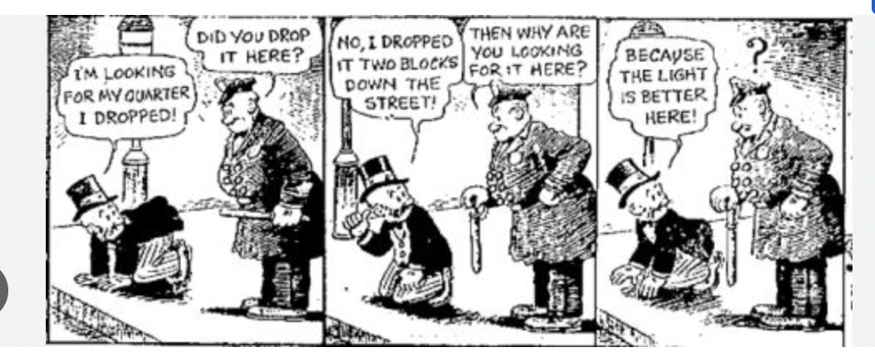
Even simpler take home message
WE NEED DATA
X-GAP, eROSITA survey, eROSITA pointed observations, XRISM for calorimeter spectra of the Fe-L dominated regime, however we really need a high effective area, high spectral resolution observatory
CCA

Slide 24
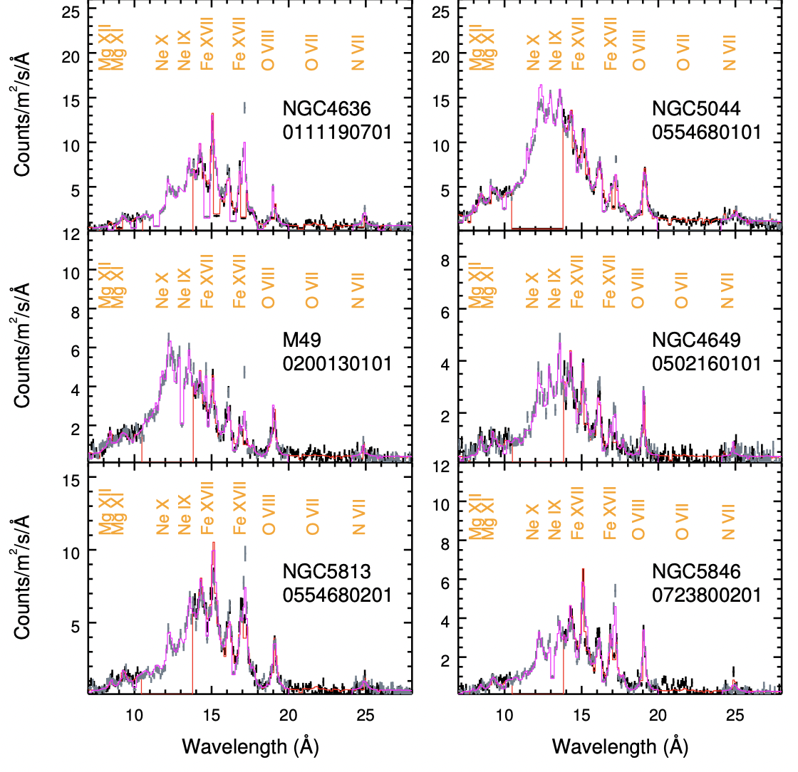
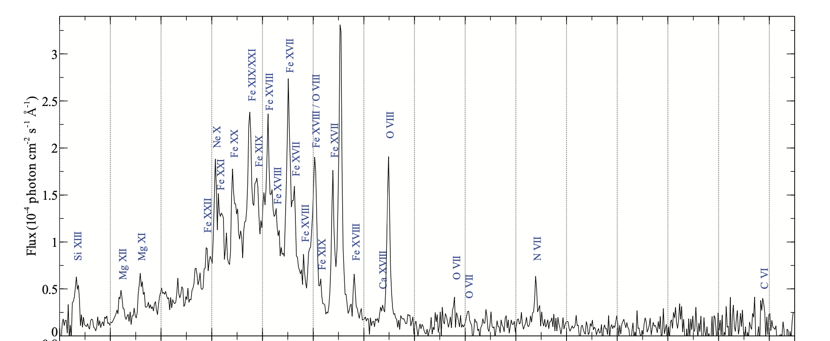
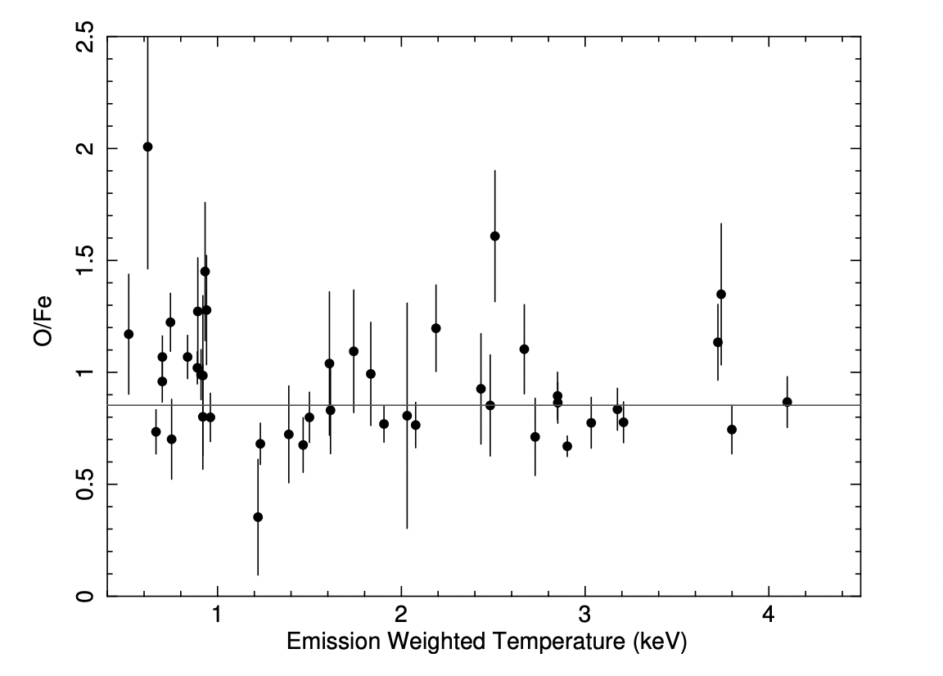
The RGS results
Sanders & Fabian 11
de Plaa+17
Mao+19
Problem of the spatial broadening, better for doing ratios of elements. N/Fe found in 3 groups (and 3 ellipticals) is super-solar pointing to enrichment from AGB stars. Detection of O VII and C VI. O/Fe constant at solar values

Slide 25
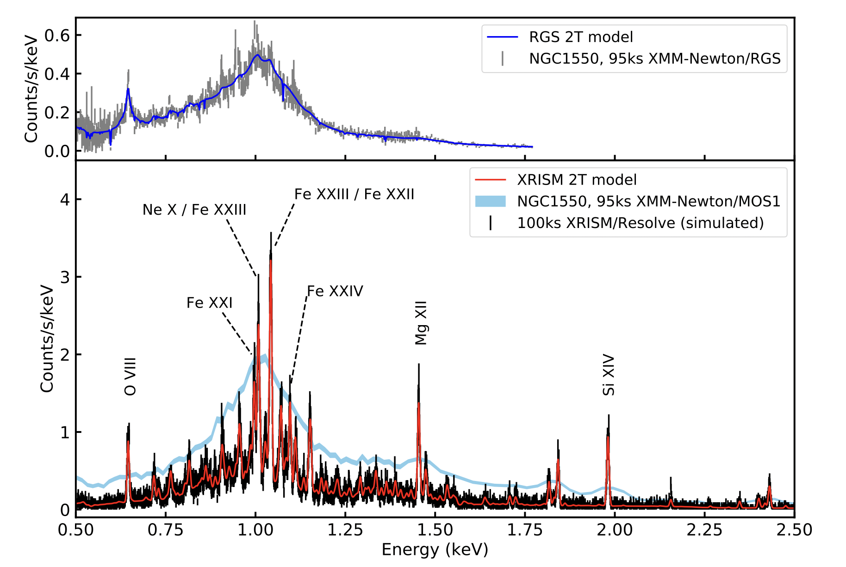
XRISM OUTLOOK
CCA
The current uncertain Athena situation should not make us forget that the launch of the calorimeter on XRISM will provide a giant leap in our understanding of abundances in the IGrM

Slide 26
Measuring abundances in the IGrM
Lovisari+21
The measurement of the density, scaling relations in the soft band are crucially dependent on the abundance

Slide 27
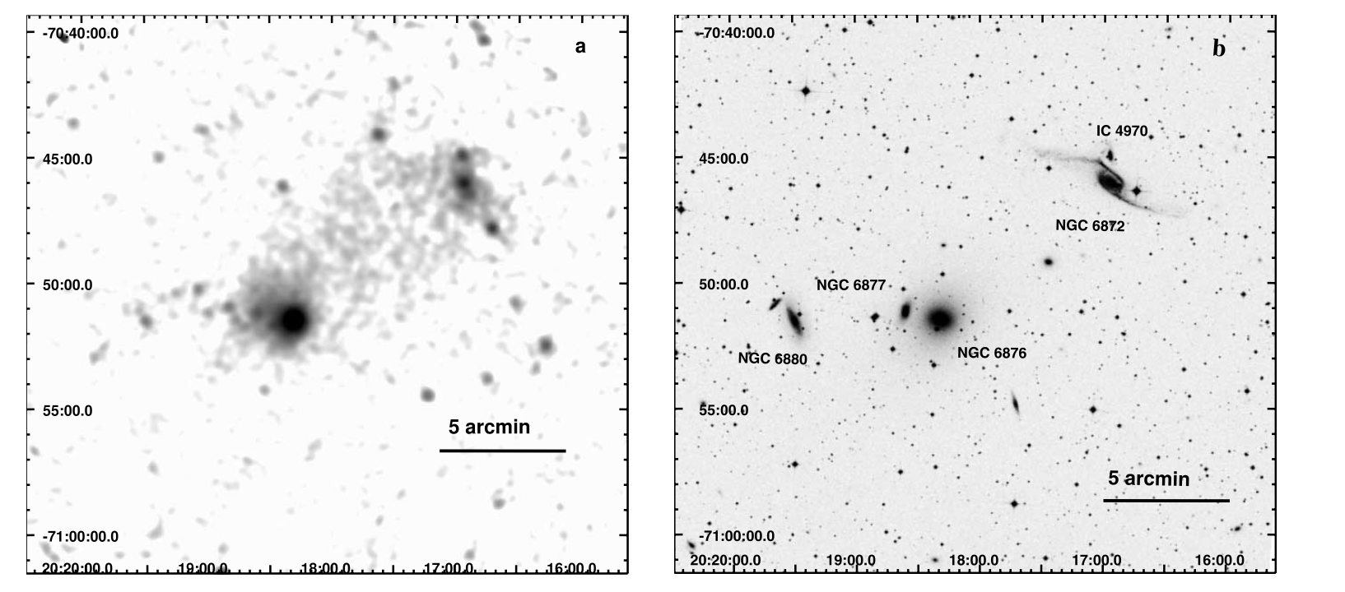
An example of NCC group
CCA
Machacek+05

Slide 28
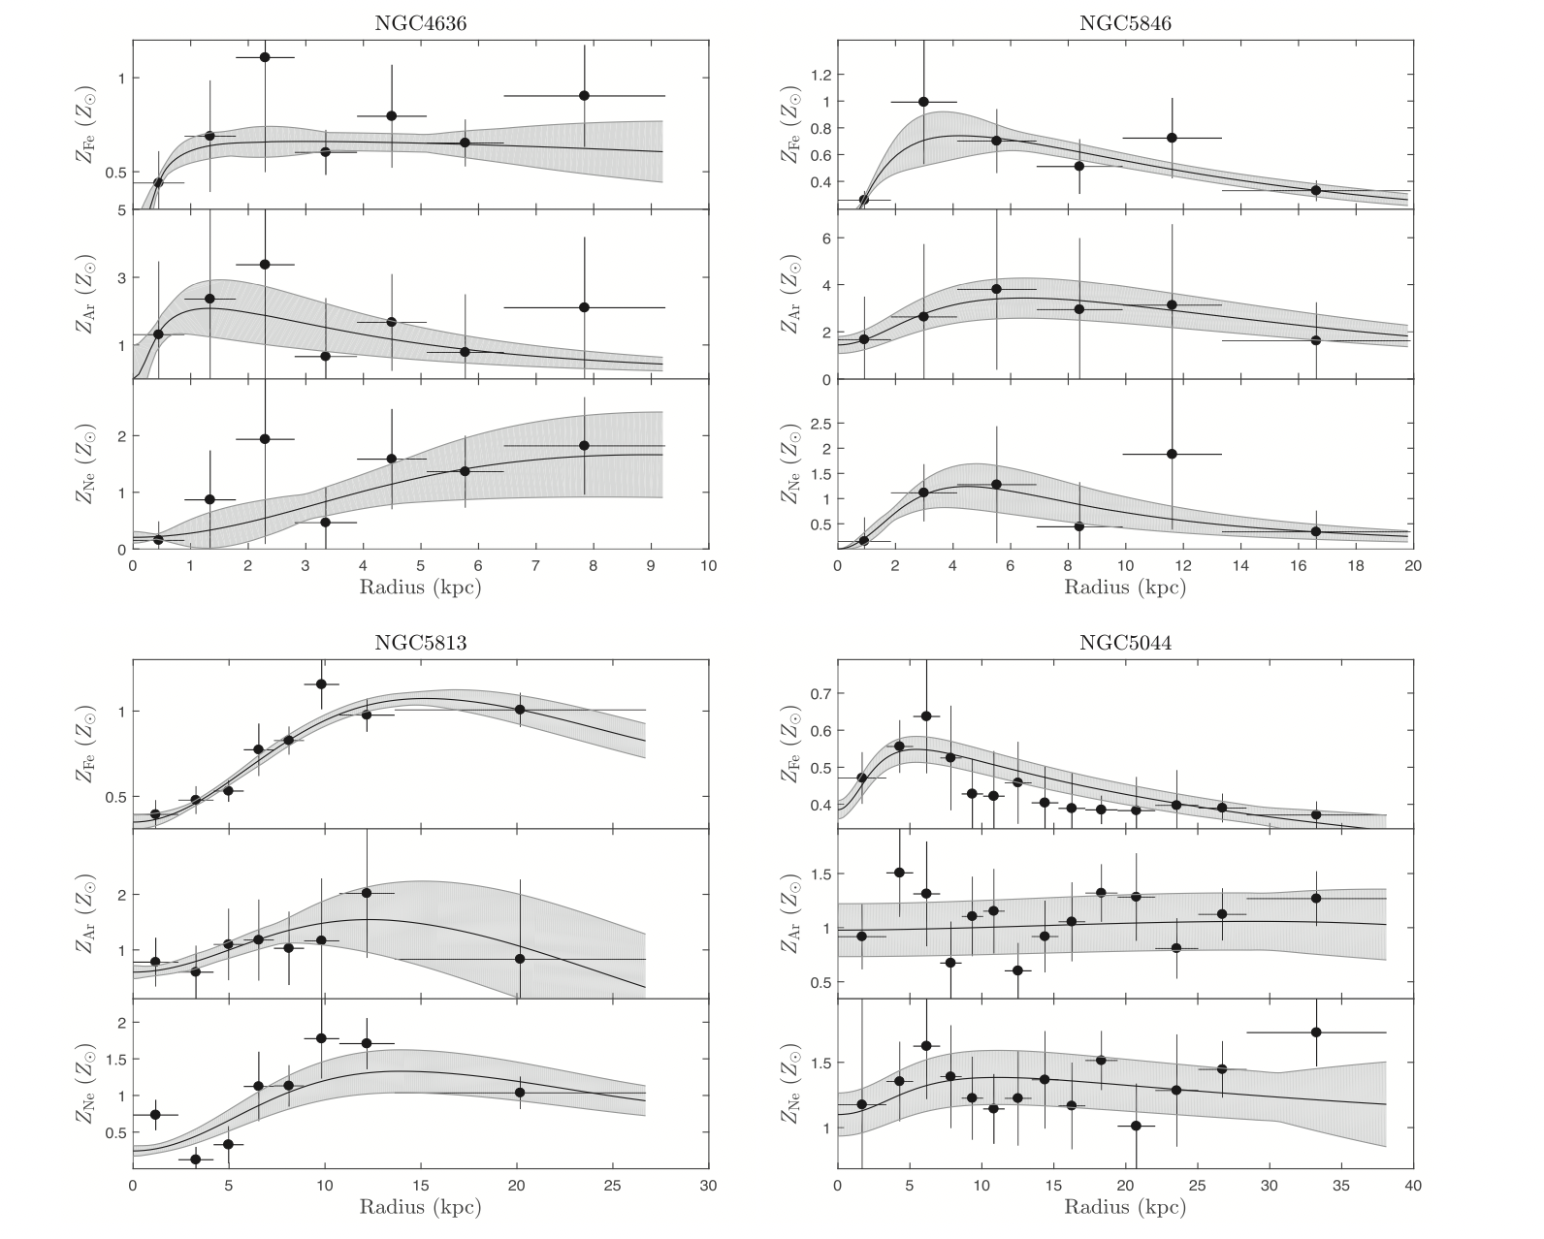
Central Abundance Drops
CCA
Liu+19
Central abundance drops suggested to be related to dust formation then transported outward by the AGN (Panagoulia+15), no resonant scattering. Noble gases such as Ar and Ne should not be affected. Still no conclusive results

Slide 29
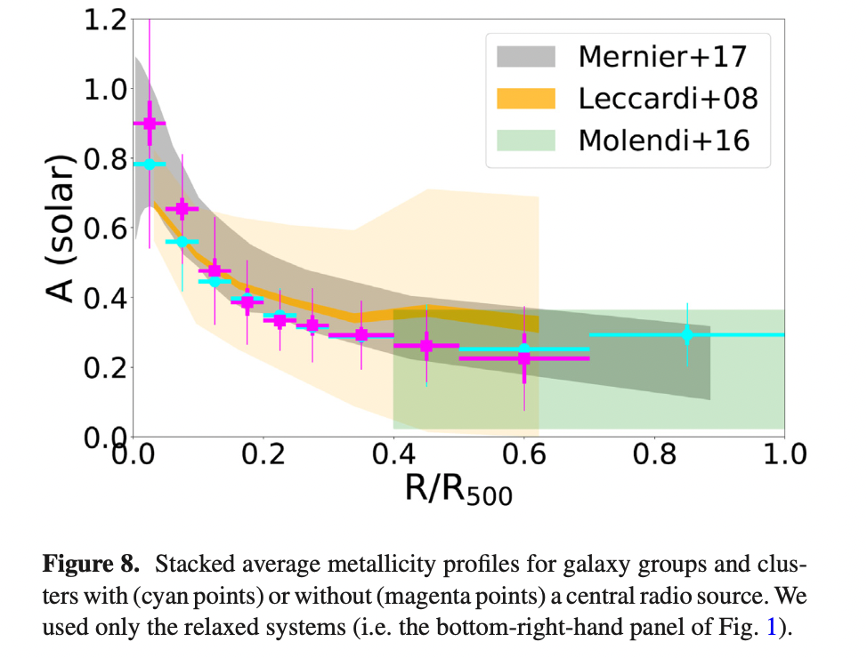
CCA
Lovisari+19

Slide 30
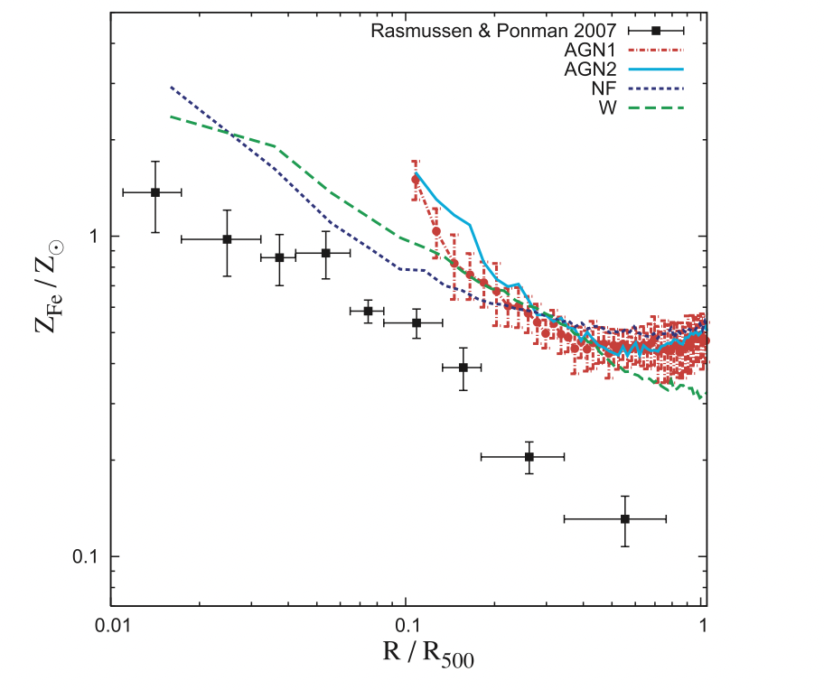
CCA
Fabjan+10

Slide 31
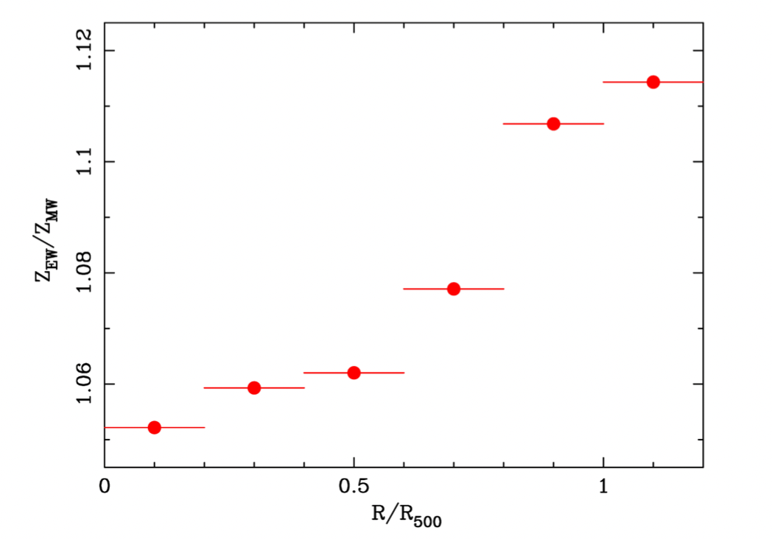
Weighing scheme
Ghizzardi+21

Slide 32
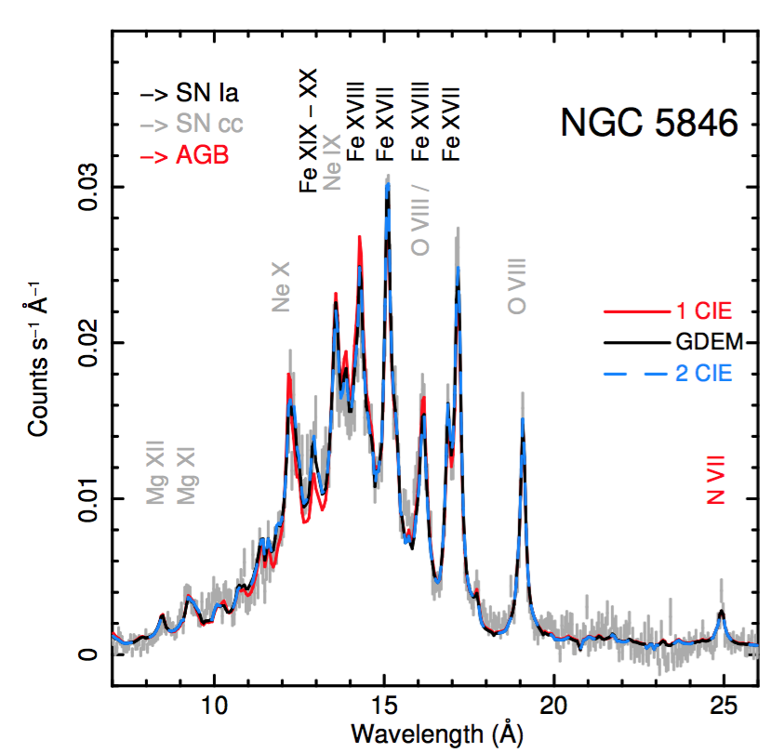
5. Metal abundances
XMM has been showing exceptional line-rich spectra in clusters
De Plaa+17
CHEERS sample

Slide 33
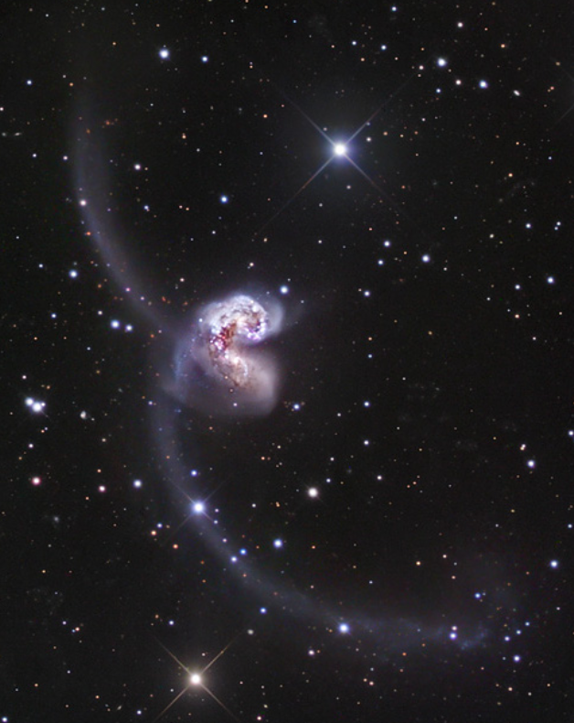
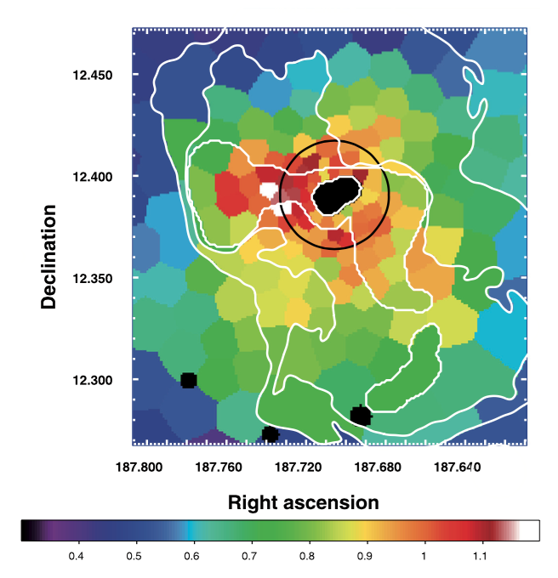
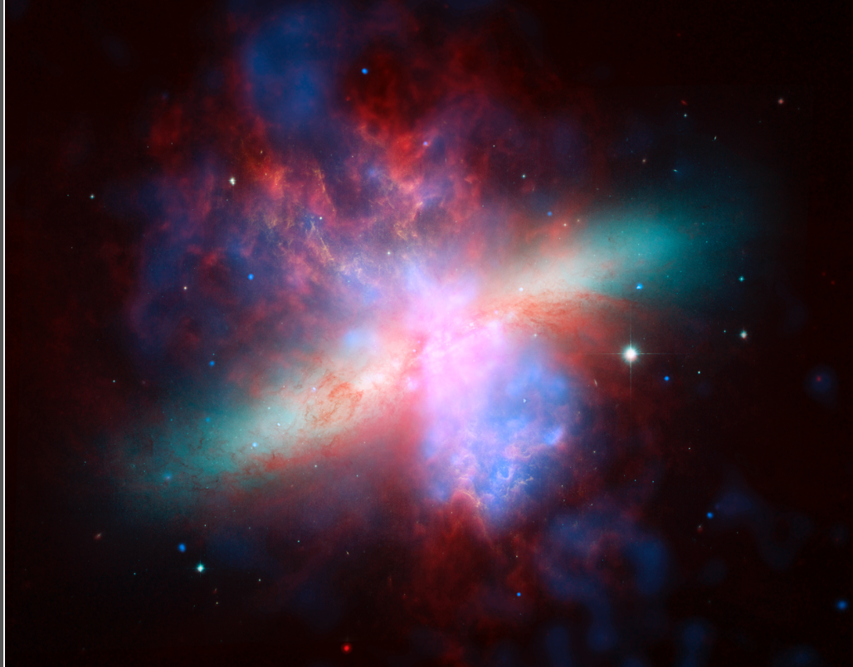
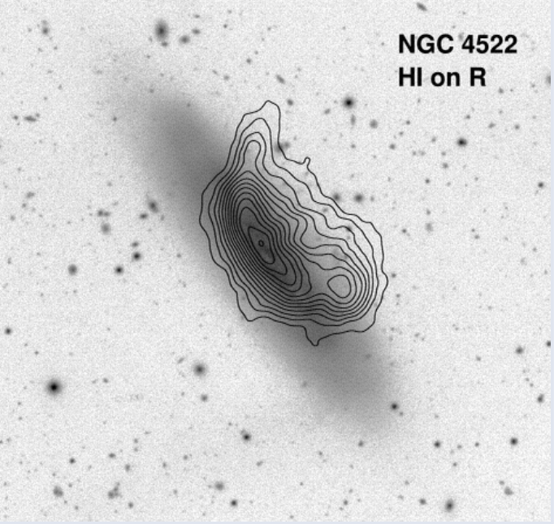
…and the process of transport of metals from galaxies to the ICM
Galaxy-galaxy interaction
Galactic winds:
M82 starbust
AGN feedback:
Simionescu+08
Ram pressure stripping

Slide 34
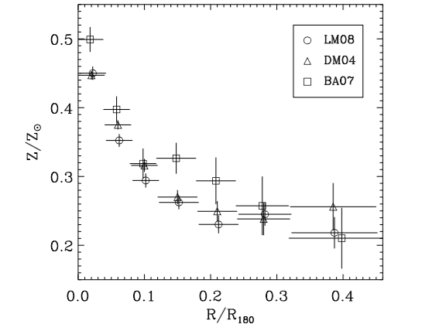
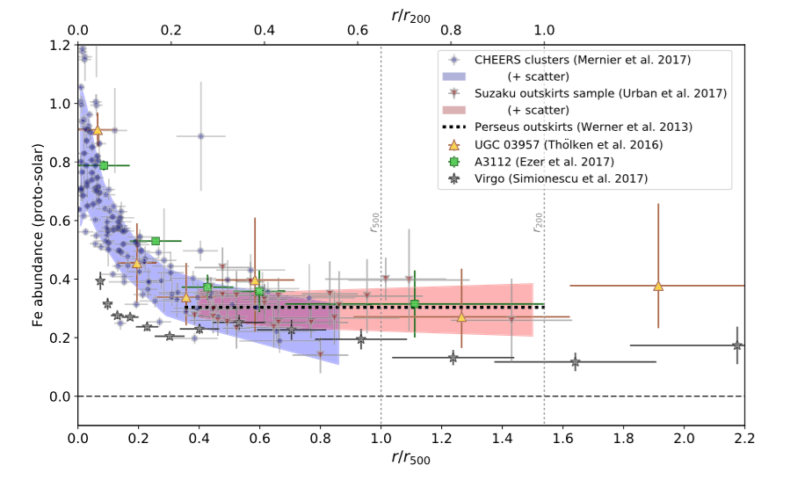
5. Metal abundances
Clusters have uniform abundances almost over their entire volume
Leccardi+08
Mernier+18

Slide 35
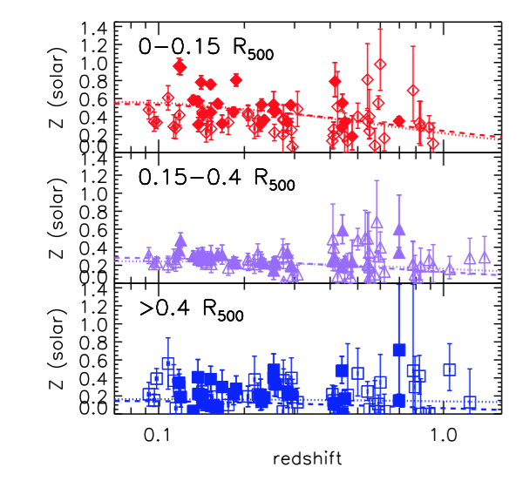
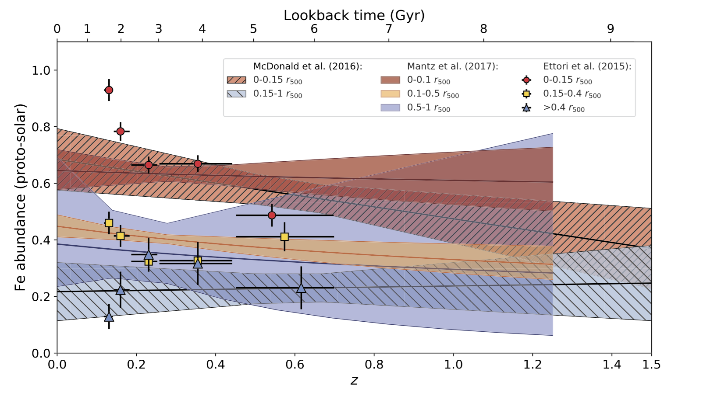
5. Metal abundances
Clusters have uniform abundances over their entire history
Ettori+15
Mernier+18

Slide 36
5. Metal abundances
Chemical enrichment of clusters happened early (z >2) with metals expelled from galaxy winds with the necessary help of AGN feedback.
Biffi+18

